Slide 1
Stevens C-Block
UBS Pitch Competition 2021
Develop Corporate Strategies for Global Disasters

Slide 2
Mentors & Team Members
Diana Portnoy (Business, Global Wealth Management)
Asher Wesley (Tech, CTO Automation office & APAC CTO)
Rong Liu (Tech, Stevens Institute of Technology, Professor)
Zeng Xu (M.S. Business Intelligence & Analytics)
Jiaxin Jiang (M.S. Business Intelligence & Analytics)
Jianxiang Zhai (M.S. Business Intelligence & Analytics)
Xuan Li (M.S. Business Intelligence & Analytics)
Jiayi Hao (M.S. Business Intelligence & Analytics)
Jungho Park (M.S. Business Intelligence & Analytics)

Slide 3
Table of Contents
Introduction (Jungho)
Topic selection
Business Problem
Key Influencers and scope
Analysis Approach
Input Data (Xuan Li, Jianxiang Zhai, Jiayi Hao)
Data Selection
Data Collection
Data Description
Methodology & output (Zeng Xu, Jiaxin Jiang)
Clustering Method (CAT)
Clustering Outcome
Financial Evaluation
Prototype Showcase (Jungho)
Conclusion (Jungho)
Findings
Q&A Session

Slide 4
Introduction

Slide 5
Topic Selection
Environmental, Social, and Governance (ESG)
Problem statement:
Develop a corporate strategy analysis pipeline and financial evaluation of strategies to identify trends and performances with regards to COVID-19

Slide 6
Business Problem
Objective 1.
Identify trends of impact and corporate strategies of COVID-19
Objective 2.
Evaluate corporate strategies to COVID-19 with respect to financial indicators

Slide 7
Key Influencers and Scope
Global economic / social risk factor
What is the scope of the risk?
Timeline, area, population, industry
Responsive Strategies
How did companies react to the risk?
Financial Index
How can we quantify the impact of responsive strategies?

Slide 8
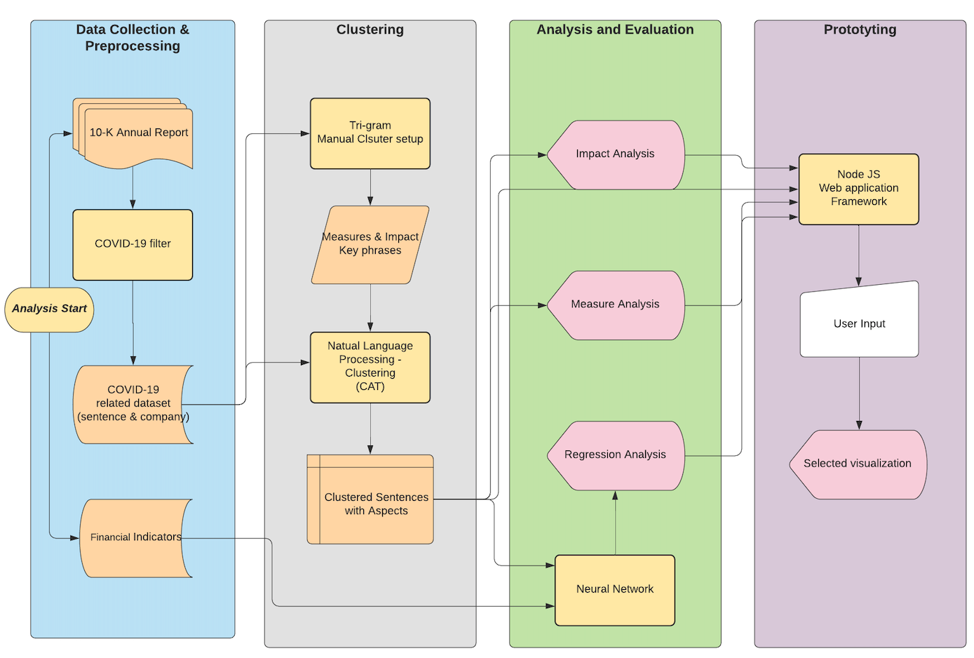
Project Flowchart

Slide 9
2. Input Data

Slide 10


Data Selection
Impact of COVID-19 / Responsive Strategies
COVID-19
2019 ~ 2021, USA, Manufacturing & service industries
Industry Selection (Standard Industry Classification codes: [2000, 3999], [7000, 8999]
Manufacturing: Supply chain, sourcing, human resources
Service: human resources, shut-down, WFH security protocols
Data: SEC EDGAR (Appendix B)
Financial Index
Use financial index to assess company’s measures to COVID-19
Regression analysis on each measures and sub-domains
Data: Wharton School of Business (Appendix C)

Slide 11
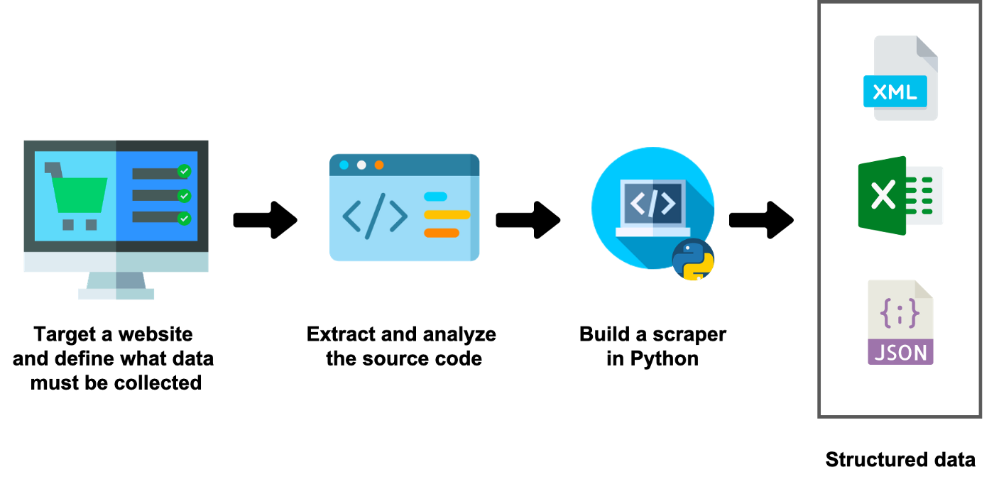
Data Collection
COVID-19 related sentences
SIK,CIK number matching
Financial indicator calculation

Slide 12


Data Description
10-K Data (2020)
From SEC
3,147 Companies
268 Subdomains
77,263 COVID-19 Related Sentences
Financial Data (2019-2020)
From WRDS Compustat Annual Report
11 Financial Indicators

Slide 13
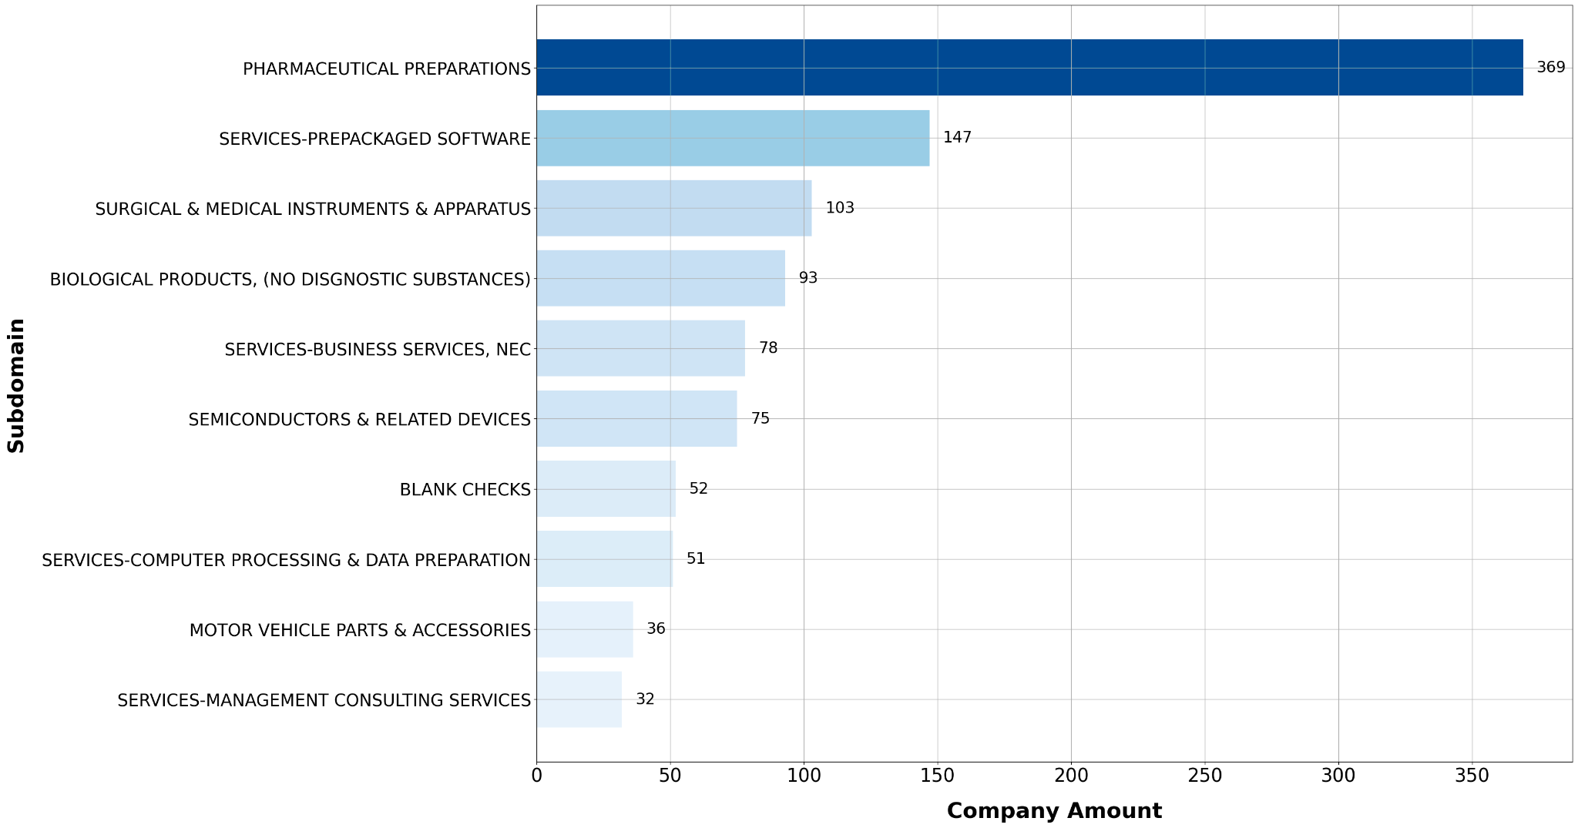
Data Description (Cont)
Subdomains
268 Subdomains
Top 6 subdomains for 2020.
Pharmaceutical Preparations
Services-prepackaged Software
Surgical & Medical Instruments
Biological Products
Services-Business Services, NEC
Semiconductors & Related Devices

Slide 14
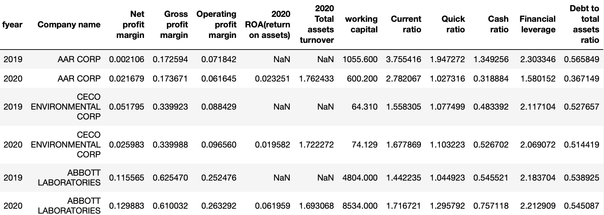
Data Description (Cont)
Financial Indicators
11 Financial Indicators
Gross Profit Margin
Net Profit Margin
Operating Profit Margin
2020 ROA(Return on Assets)
2020 Total Assets Turnover
Working Capital
Current Ratio
Quick Ratio
Cash Ratio
Financial Leverage
Debt to Total Assets Ratio

Slide 15
3. Methodology & output

Slide 16



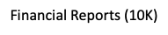


Clustering
Objective: Identify specific strategies and impacts clusters related with COVID from copious filings.
Application: Working as a filing reader, help investors efficiently get crucial information, key phrases related to a certain topic from Financial reports (10K, 10Q, 8K, etc.)
1.XPath
2.Stanza
1.K-Mean2. GMM
3. LDA
4. CAT
Preprocessing
Clustering

Slide 17
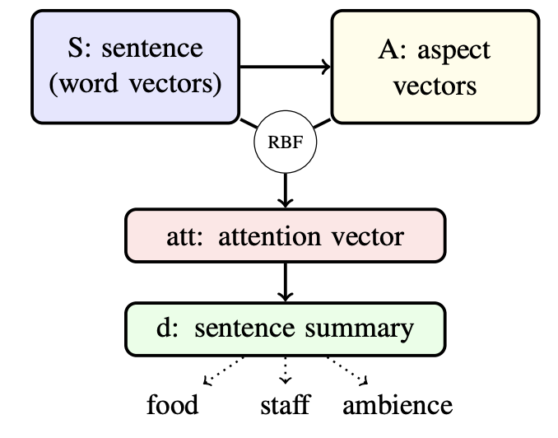
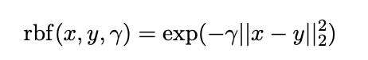
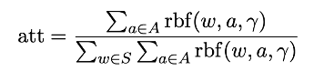
Clustering method - modeling
CAT：
(Appendix D)
An unsupervised method based on single-head attention mechanism and RBF kernel
Working well for extracting more relevant key phrases or aspects from short sentences
Input: Sentence POS-tagger, and In-domain word embedding(Gensim, BERT)
Output: Key phrases(aspects) for each sentence, representing certain strategy or impact

Slide 18
Clustering -modeling
Output example: LULULEMON ATHLETICA INC.
46 Covid related sentences, 14 aspects (measures and impacts)
Impacts: “disruption supply”, “impose travel restrictions”
“Our supply of fabric or manufacture of our products could be disrupted or delayed by the impact of global health pandemics , including the current COVID - 19 coronavirus pandemic , and the related government and private sector responsive actions such as border closures , restrictions on product shipments , and travel restrictions.”
Measures: “temporarily suspend”, “avoid gatherings”
“Subsequent to February 2 , 2020 , in line with recommendations by public health officials and in accordance with governmental authority orders , the Company has taken actions to close certain retail locations and to reduce operating hours.”

Slide 19
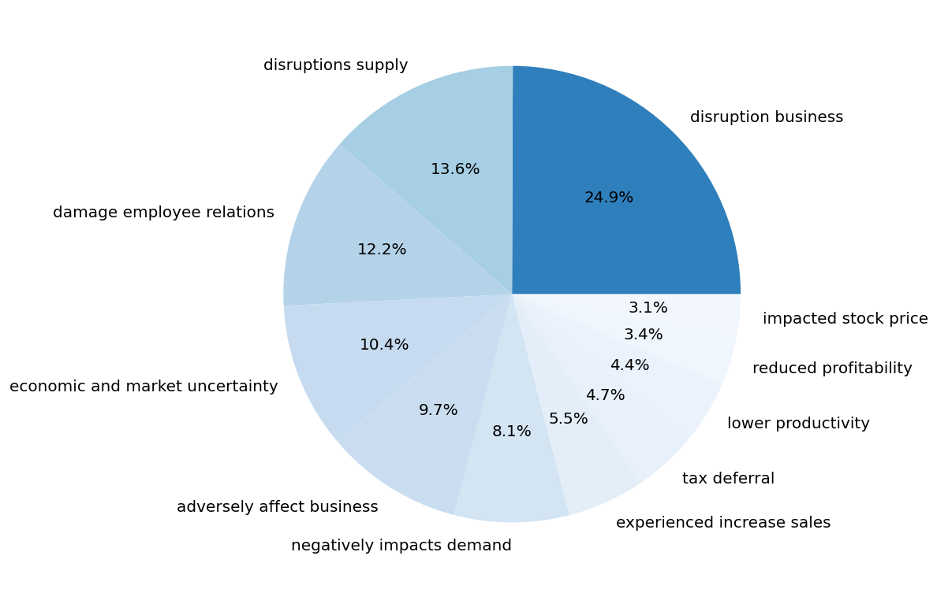
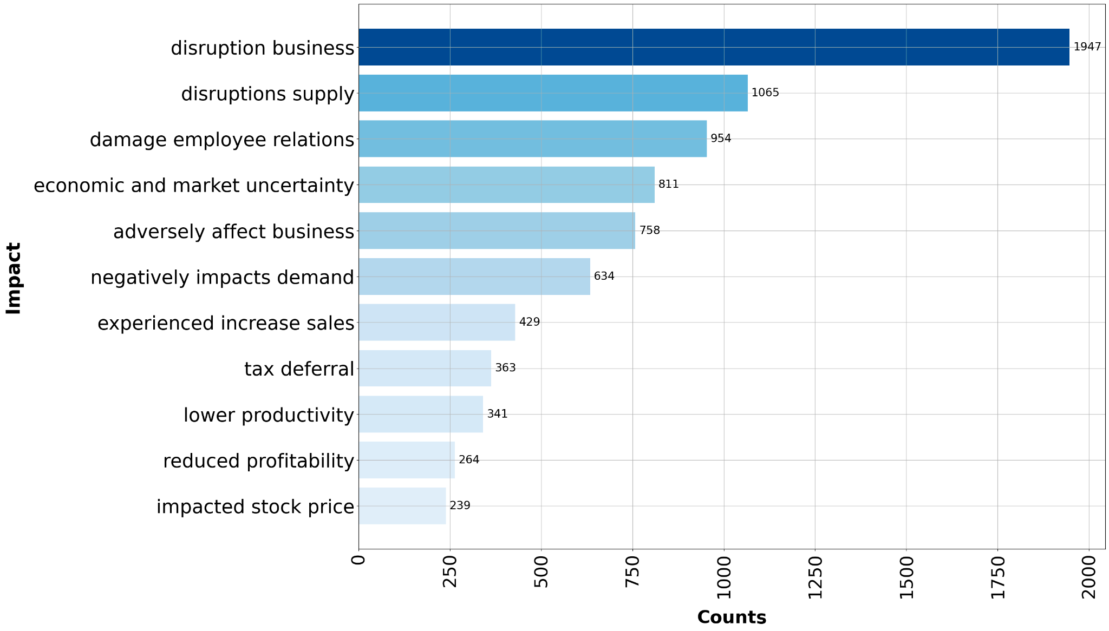
Clustering Outcome (Impact)
Impacts of COVID-19 on the manufacturing and service industries
(from 10-K of 3000+ public companies)
Top N clustering results for impact of COVID-19
Disruption on business (24.9%)
Supply disruption (13.6%)
Damage employee relations (12.2%)
Impacts of COVID-19 are mainly on supply chain, human capital management, productivity, profitability, and market uncertainty.
1 positive impact: experienced increase sales

Slide 20
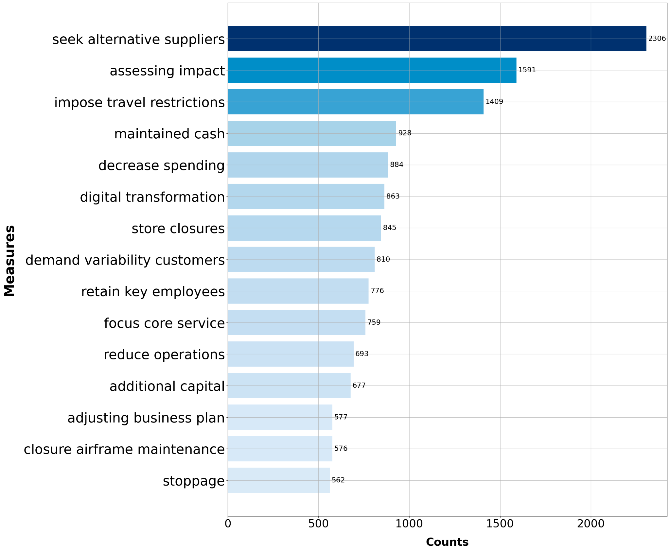
Clustering Outcome (Measures)
Measures of COVID-19 on the manufacturing and service industries (3000+ public companies)
The first 15 of the 36 measures
Frequency of measures in 2020
Data preprocessing
Establish a correlation matrix between measures.
Combine some measures with a correlation greater than 0.5.
E.g combine 'reduce expenses' and 'decrease spending'
Measures cut from 45 to 36
Top 5 measures
Seek alternative suppliers (2306)
Assessing impact (1591)
Impose travel restrictions (1409)
Maintained cash (928)
Decrease spending (884)
Measures mainly focus on assessing impacts of COVID-19, social distancing, supply chain, human capital management, and cost management.

Slide 21
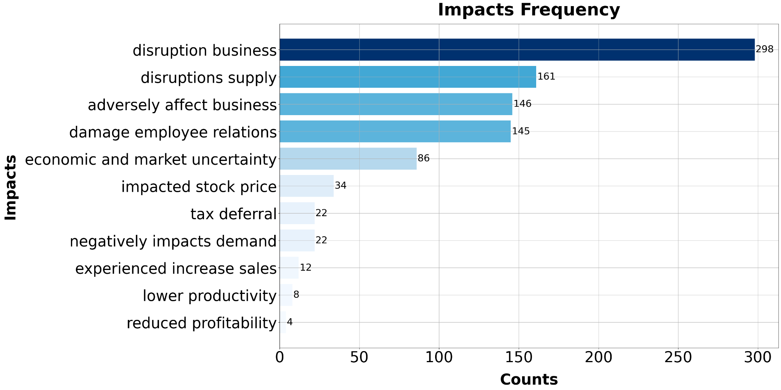
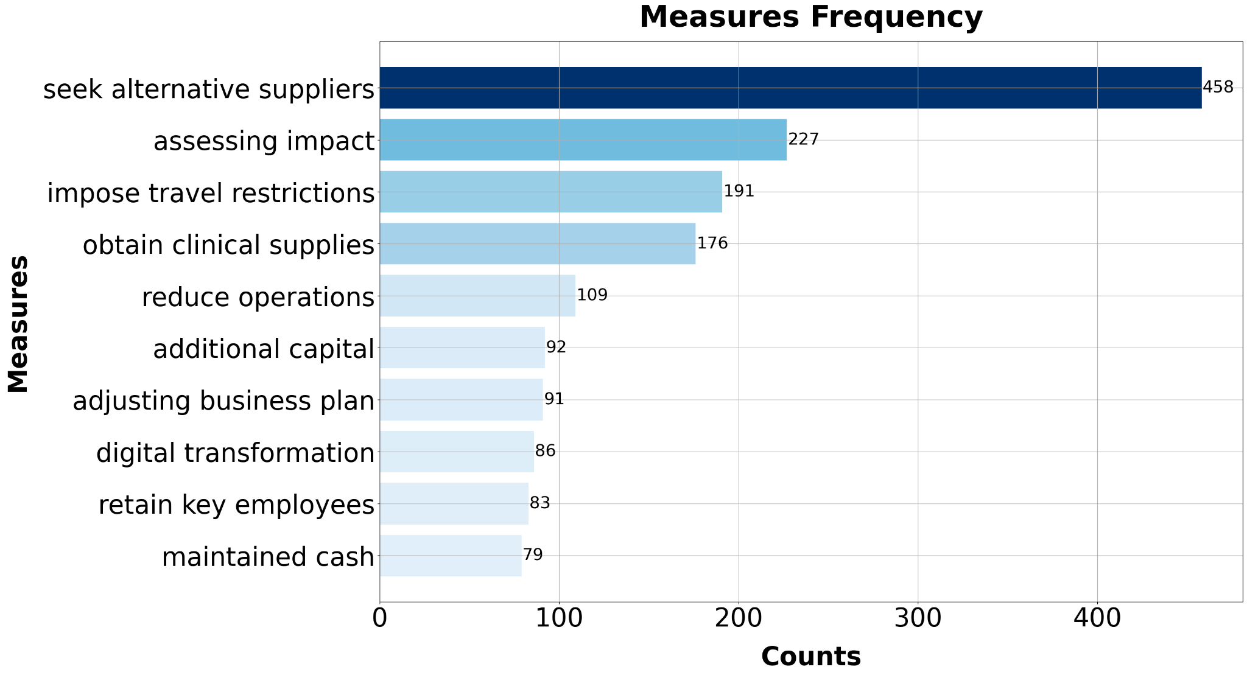
Manufacturing Industry
Pharmaceutical Preparations (1st largest sub-domain in manufacture industry)
Top 5 impact type
Business disruption
Supply disruption
Adversely affect business
Damage employee relations
Economic and market uncertainty
Top 5 measures
Seek alternative suppliers
Assessing impact
Impose travel restrictions
obtain clinical supplies
reduce operation

Slide 22
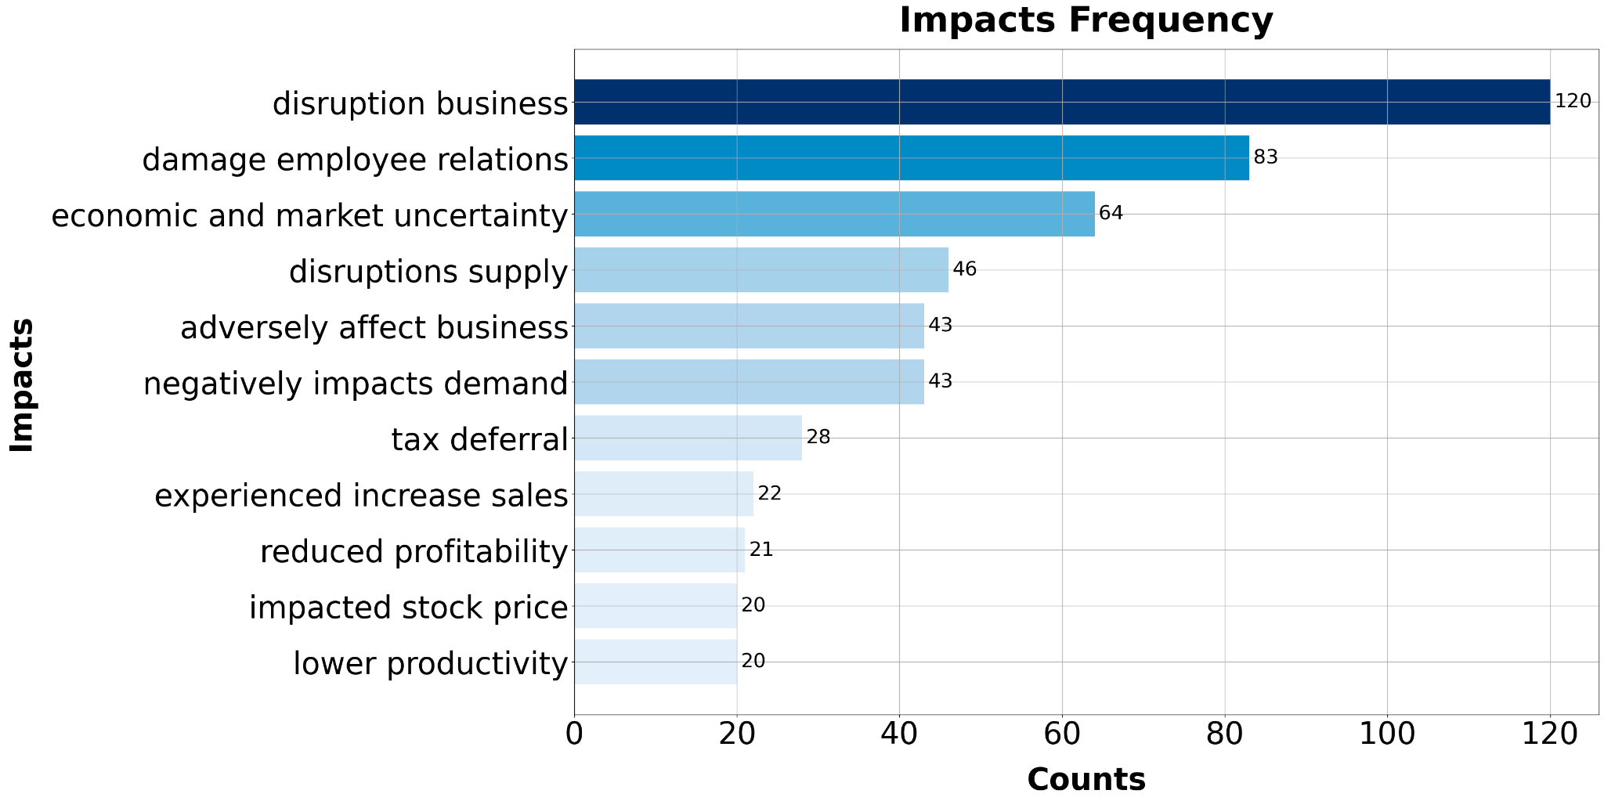
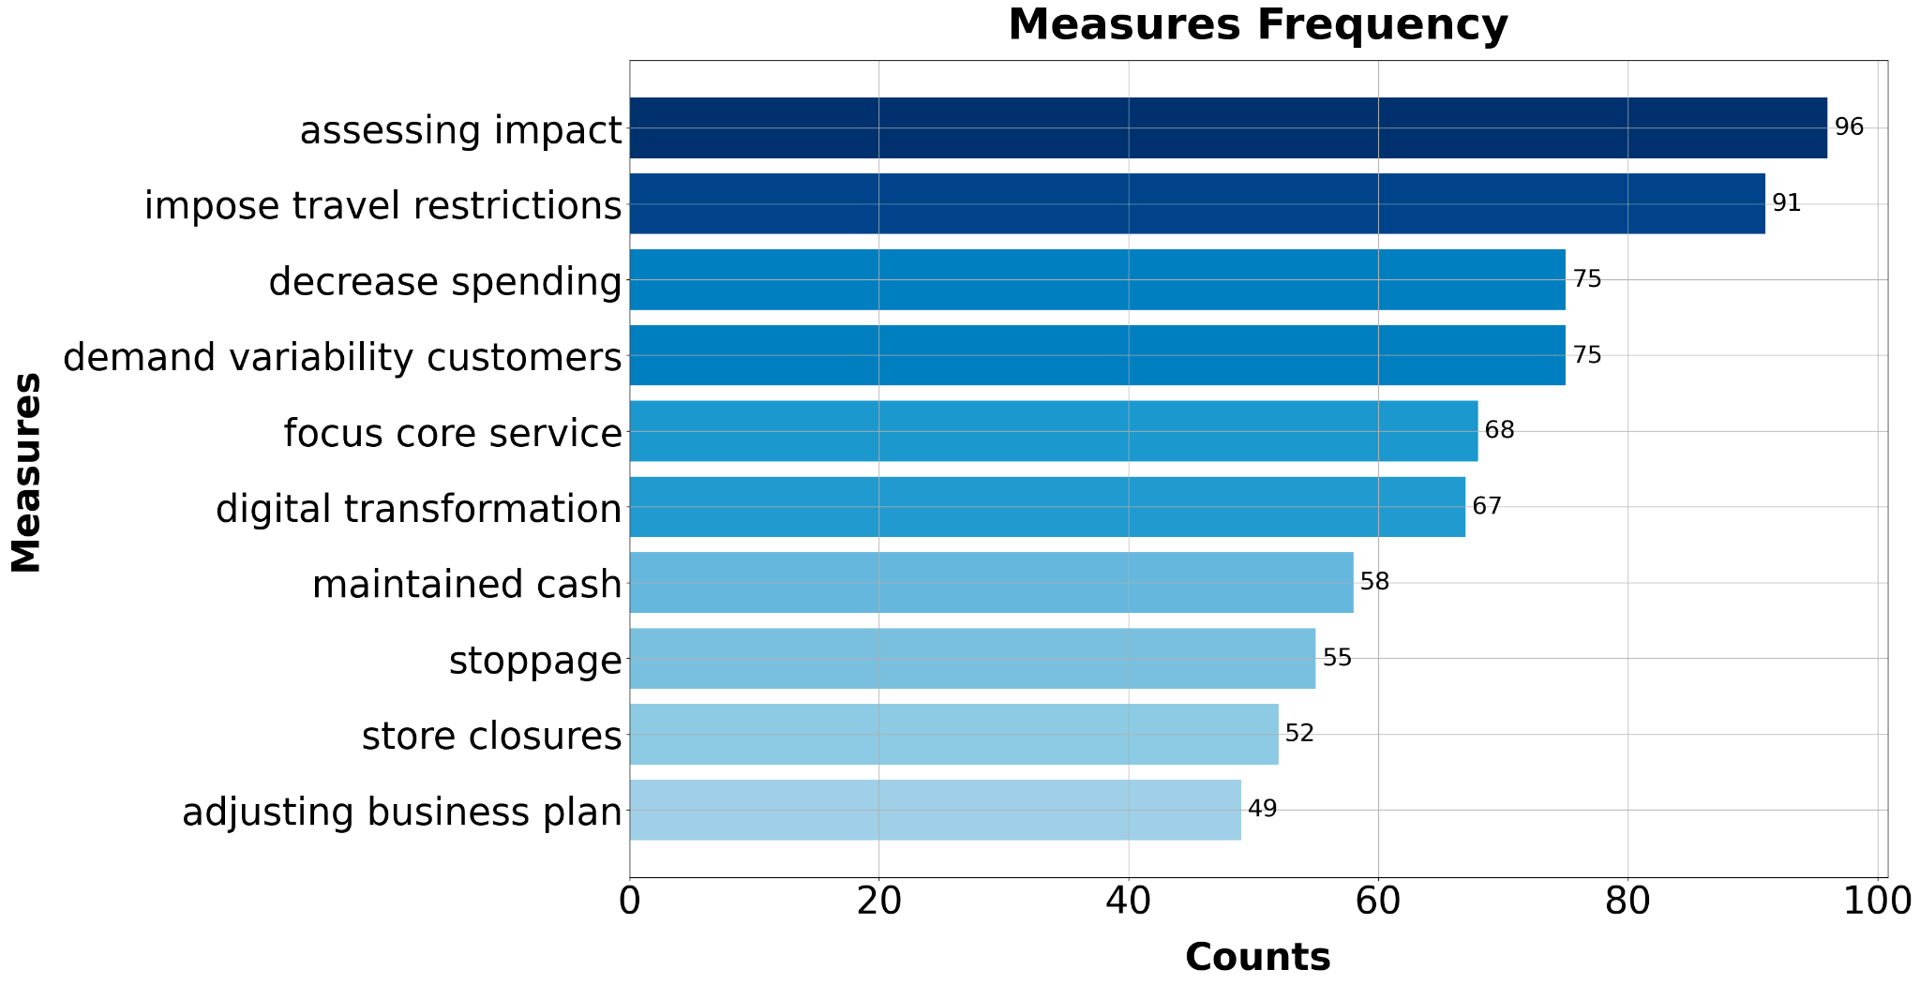
Services Industry
Services-Prepackaged software (1st largest sub-domain in the services industry)
Top 5 impact type
Business disruption
Damage employee relations
Economic and market uncertainty
Supply disruptions
Adversely affect business
Top 5 measures
Assessing impact
Impose travel restrictions
Decrease spending
Demand variability customers
Focus core service

Slide 23
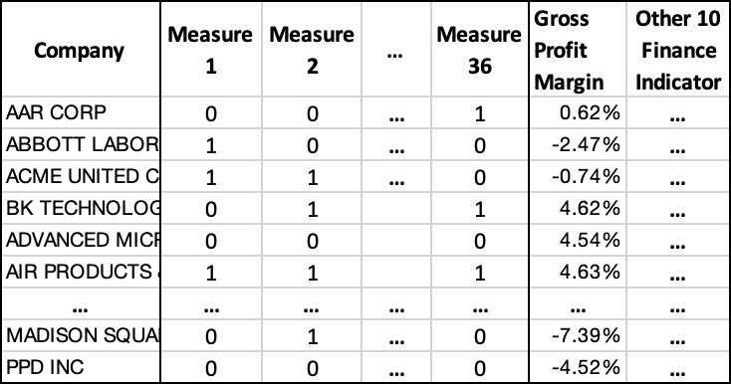
Evaluation — Regression Model
Exploring the problem: Under the pandemic, how companies can achieve the improvement of their financial indicators through a combination of different measures.
xi:36 Measures Features
yi: 11 Financial Indicators
Regression model: Neural Network Training
[
x1
w1
x2
w2
x3
w3
linear
h(xi,w)=yi
...
w36
x36
[
x is binary
If x = 1, it means the company has taken this measure.
If x = 0, it means not.
Outputs [w1, w2, w3 … w36]
For each financial indicator, the weight value of measures.
- Positive weights promote financial indicators.
- Negative weights lower financial indicators.

Slide 24
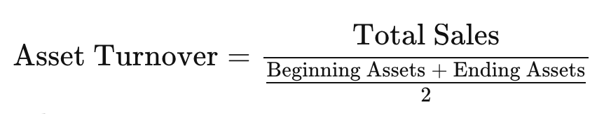
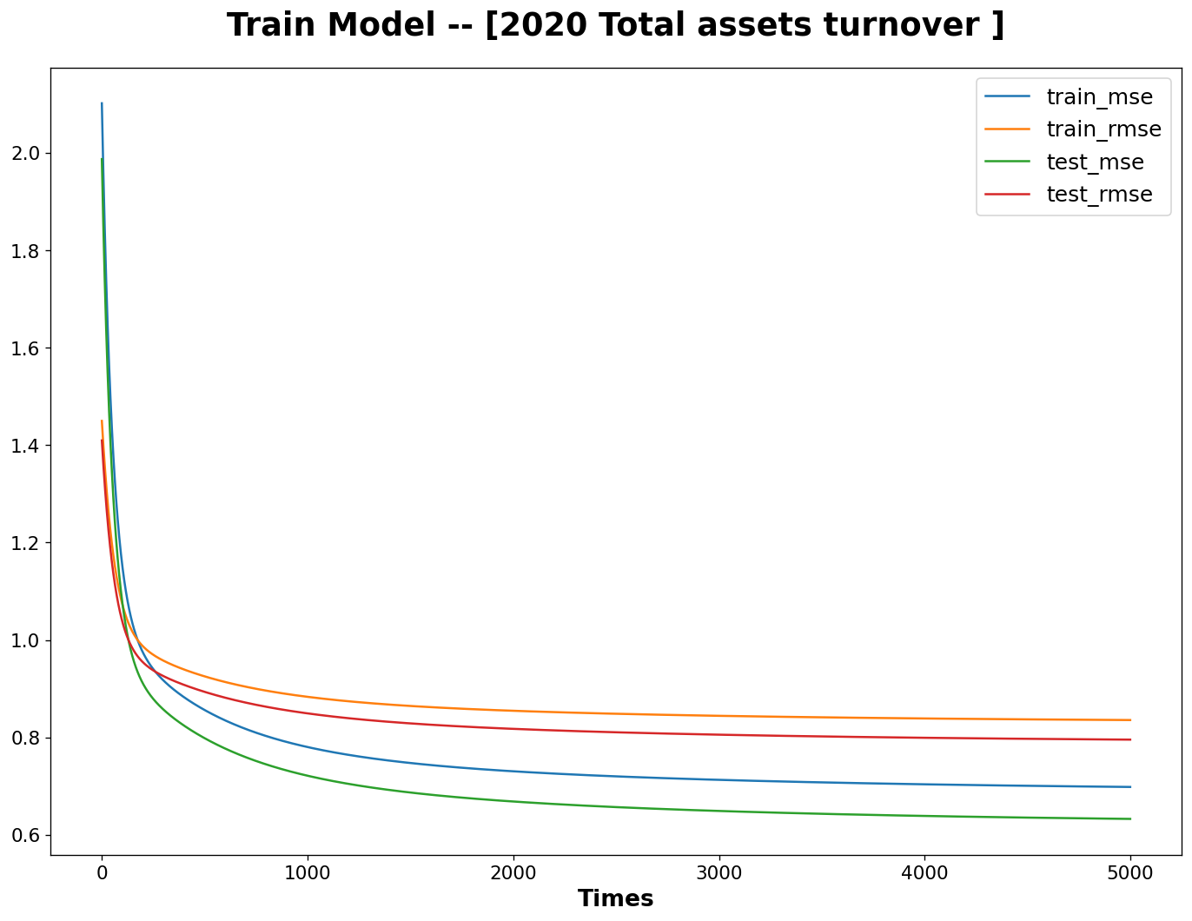
Evaluation — Model Result
One of 11 financial indicators, total asset turnover
Measures to total assets turnover
Top 3 Positive measures:
obtain clinical supplies
impose travel restrictions
assessing impact
Top 3 Negative measures:
reduce staffing
reduce inventory levels
store closures
After 5000 iteration, mse = 0.632 and rmse = 0.795
Model Improvement
1. Enlarge sample size 2. More specific measures

Slide 25
4. Prototype Showcase

Slide 26
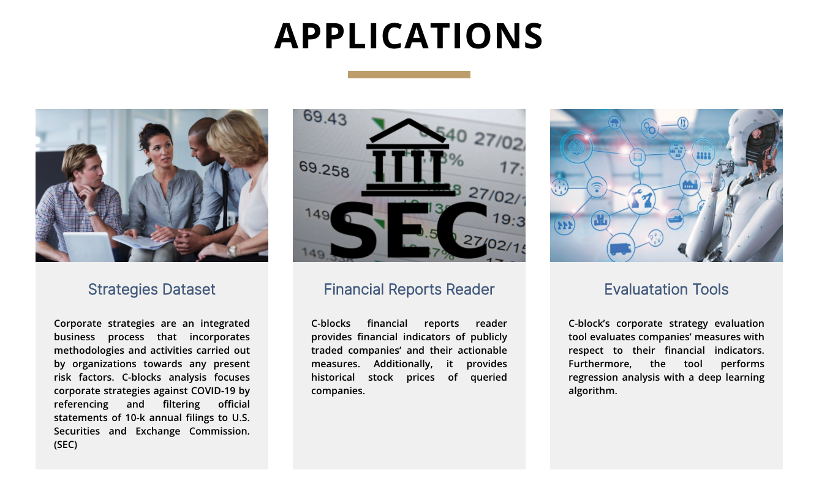
Prototype showcase
Web application development for users
COVID-19 related clusters and sentences of industries
Financial reports reader
Evaluation results

Slide 27
Conclusions
Transferable analysis approach to other crisis / industries
Assess:
Impacts of risk factor on industry (high-level)
Company’s measures, frequency distribution measure on sub-domain & high-level
Future works
Enlarge data size, creating more clusters and getting more specific measures companies took
Further enhance clustering and regression model accuracy
Add more sections in the c-block website.

Slide 28
Who can be beneficial?
Company
Stakeholders:
Find similar patterns within industry sub-domain
Achieve improvement of a specific financial indicator
Managers:
Construct or reconsider current protocol/strategy against the risk factor
Social
Economy: Recommend measures with positive coefficients to a certain industry
Politics: Mitigating economic/social crises caused by future disasters

Slide 29
Q&A session

Slide 30
Thank you for your time!

Slide 31
Technical Appendix
Appendix A. C-Block Dataset and Source Codes
Appendix B. SEC EDGAR Search engine
Appendix C. Financial Index Data Provider
Appendix D. Paper： Embarrassingly Simple Unsupervised Aspect Extraction

